Slide 1

Big Data and Artificial Intelligence in Finance

Slide 2

Overview of topic
What's an AI ?
Machine learning techniques
What happen when AI and Big Data combine ?
Who is FSB ?
AI and machine learning in Finance
Big data in Finance
Some use cases of AI and machine learning in Finance
Demo of one of the use case in python

Slide 3
“A.I” Is what computers can’t yet do
“Weak” A.I
Intelligence provided by the programmer
e.g : Use of software to study or accomplish specific problem solving or
resolving tasks ( Chess)
“Applied” A.I
Intelligence but in a very limited field
e.g : Most focus today is in Applied A.I like Deep Learning (Face recognition
or Autonomous Vehicles). Most of commercial A.I. is based on Machine
Learning algorithms (Neural Networks, Decision tree, K means, SVM)
“General” A.I
Intelligence, but not limited to a narrow field where humans still have to impose certain rules before it can “learn”
e.g : Attempts to perform the full range of human cognitive abilities ( Sophia)

Slide 4
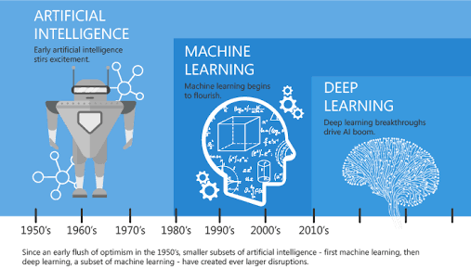

“ Never send a human to do a machine’s job”
- Agent Smith

Slide 5
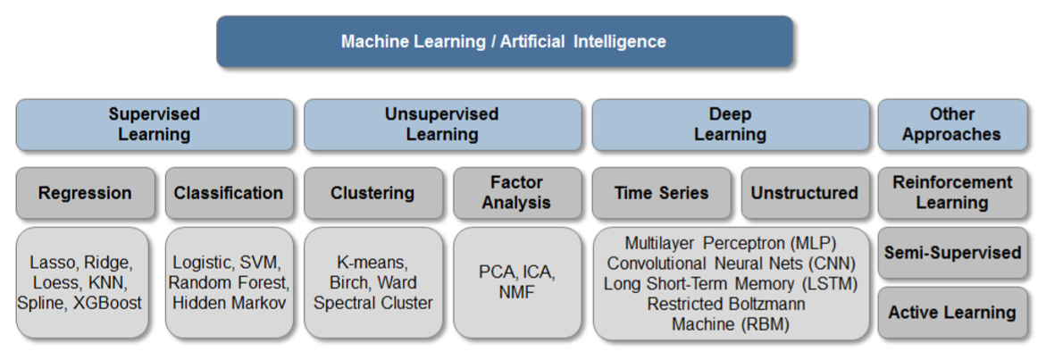
Classification of Machine learning Techniques

Slide 6
What happen when A.I and Big Data combine ?

Slide 7

FinTech :
Application of new technologies to connect and better serve consumer and business customers
RegTech :
Utilizes various technologies to establish enterprise-wide data governance and reporting
SupTech :
Improving efficiencies of regulators and institutions benefits from those advances

Slide 8
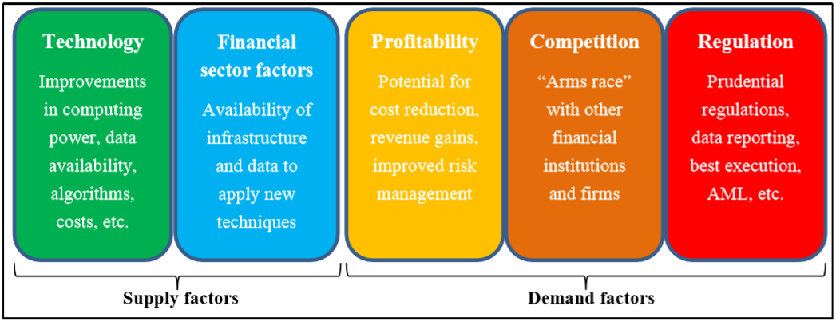
Supply and demand factors of financial adoption of AI and machine learning

Slide 9
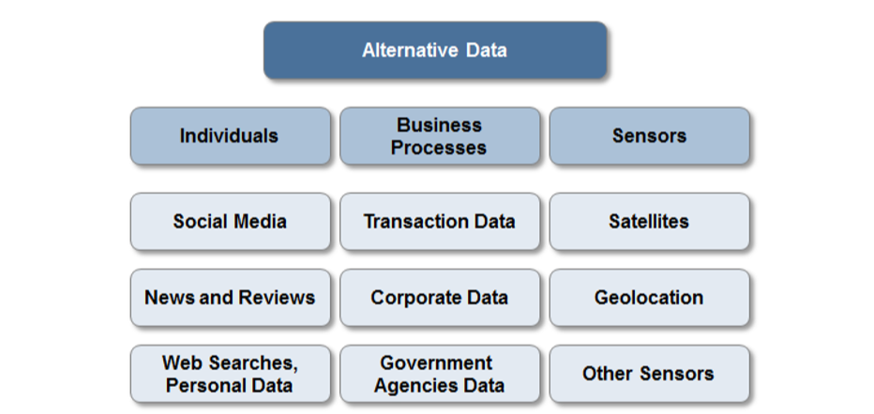
Classification of Big/Alternative Data sources in Finance (Trading strategy)
*Alternative data (in Finance) sets are often categorized as big data, which means that they may be very large and complex

Slide 10
Some use cases of AI and machine learning :
Uses by financial techniques for regulatory compliance (‘RegTech’) or by public authorities for supervision (‘SupTech’)
Customer focused uses
Operations-focused uses
Trading and portfolio management in financial markets

Slide 11
Uses by RegTech or SupTech
Micro-financial analysis
  Possible effects on financial markets
  Possible effects on financial institution
  Possible effects on consumer and investors
Macro-financial analysis
  Market concentration and systematic importance of institution
  Potential Market vulnerabilities
  Network and interconnectedness

Slide 12
Customer focused uses
Credit scoring applications
Use of pricing, marketing and managing insurance policies
Client-facing chatbots

Slide 13
Operations-focused uses
Capital optimisation use case
Model risk management and stress testing
Market impact analysis

Slide 14
Trading and portfolio management in financial markets
Trading execution
Portfolio management

Slide 15
DEMO

Slide 16

Thank You !
Q&A Time

